Slide 1
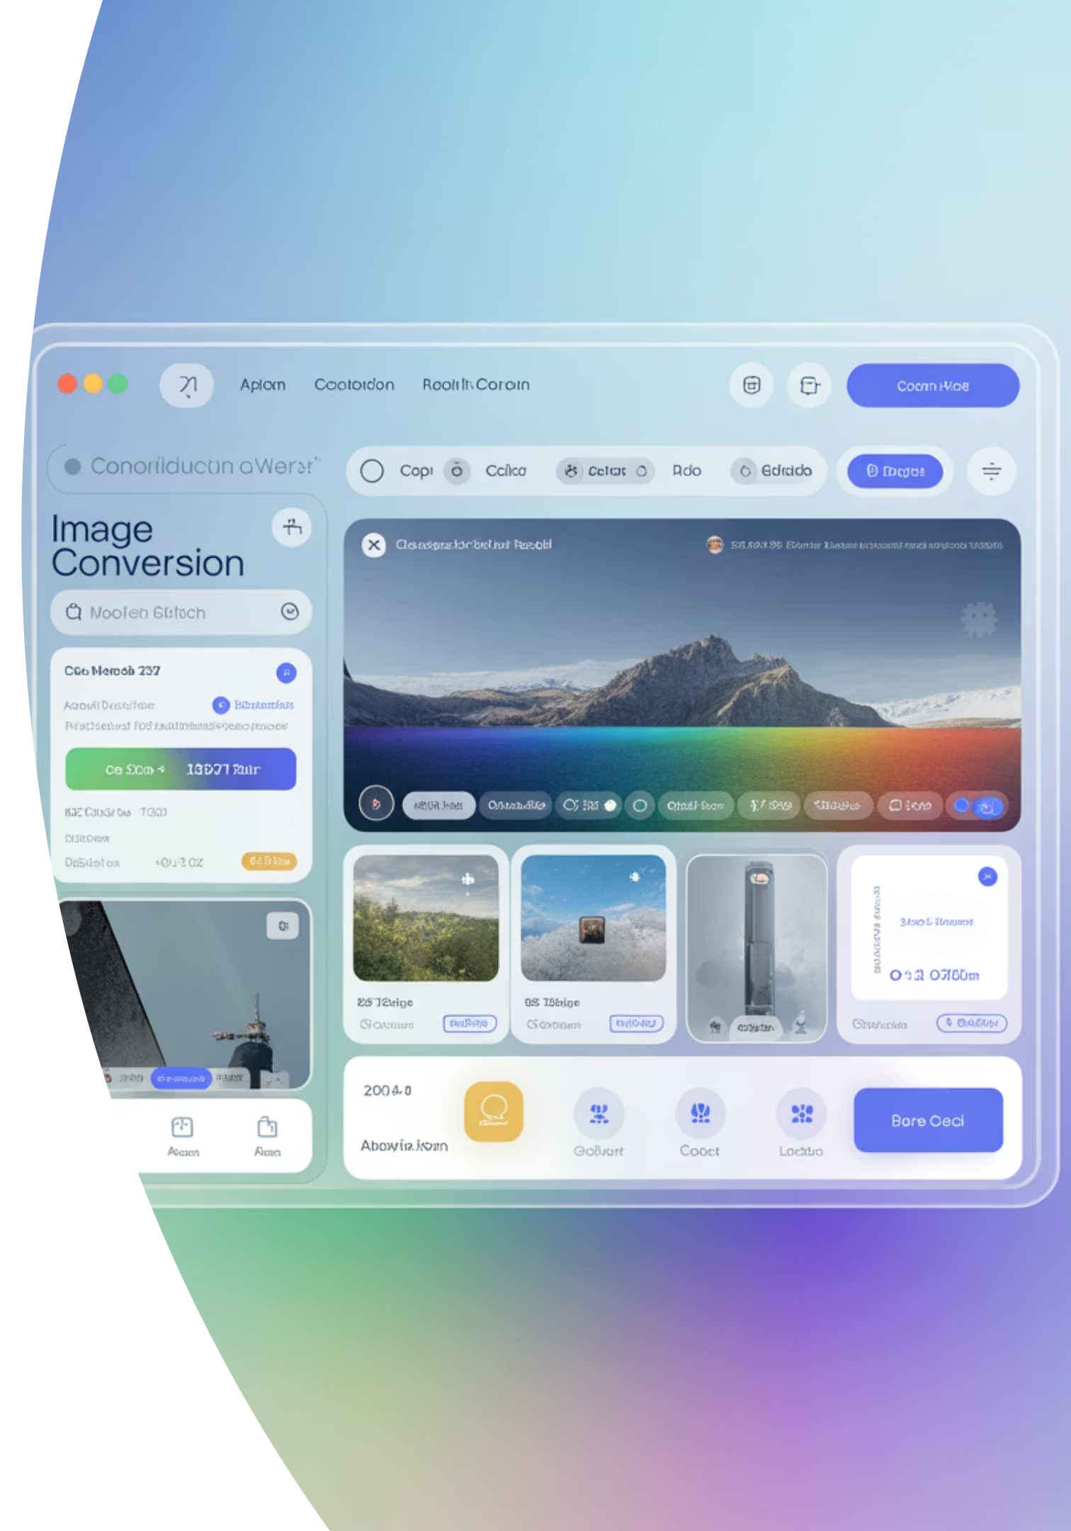
Image to Grayscale Converter using NumPy and PyQt
A desktop application demonstrating pixel-level image processing through pure numerical computation
Anurag Paul (22MID0080), Kinjal Ghosh (22MID00331), Pratik A Shah (22MID0281), Dhanushvanth VH (22MID0063)

Slide 2
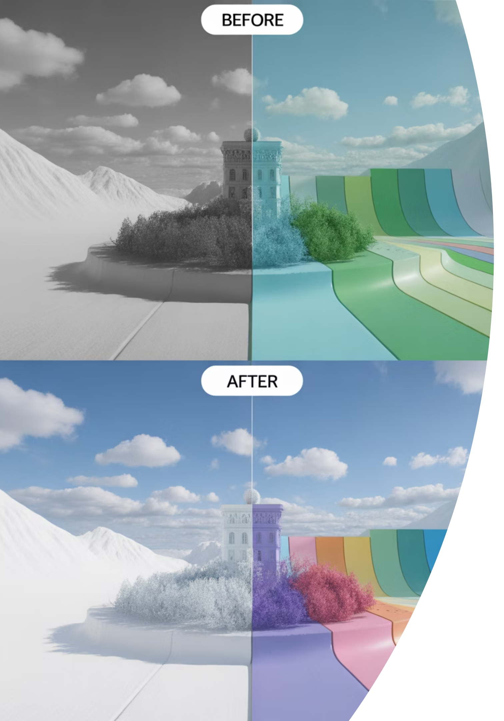

Project Overview
This project implements a simple yet effective desktop application that converts any given colour image into its grayscale equivalent using NumPy-based pixel-level computation.
Core Objective
Demonstrate how basic matrix and numerical operations can be effectively utilized for image manipulation
The application is developed with PyQt5 for the graphical user interface and relies solely on NumPy for image data processing — without using any specialized image processing libraries such as OpenCV or Pillow.
The program supports both file selection and drag-and-drop image loading, displays the original and grayscale images side by side, and allows users to save the generated grayscale image.

Slide 3



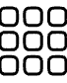




Project Objectives
Intuitive GUI
Pure NumPy Processing
Build an intuitive GUI application for converting colour images to grayscale with seamless user interaction
Perform grayscale conversion purely using NumPy operations without OpenCV or Pillow dependencies
PyQt Integration
Array-Level Manipulation
Enable user interaction through PyQt with image loading, visualization, and saving features
Understand how pixel data can be accessed and manipulated at the array level using NumPy

Slide 4
Tools and Technologies
Component
Technology / Library
Programming Language
Python 3
GUI Framework
PyQt5
Image Processing
NumPy
Development Environment
VS Code / PyCharm / IDLE
Supported Formats
PNG, JPG, JPEG, BMP, GIF

Slide 5



Project Architecture
The project integrates GUI design with numerical computation using a layered approach that separates user interaction from processing logic.
Frontend Layer
Developed using PyQt5, providing buttons and drag-and-drop functionality. Displays two image panels for original and grayscale versions with "Load Image" and "Save Grayscale" buttons.
Backend Processing
Selected image loaded as QImage object, raw pixel buffer converted to NumPy array. RGB pixel values processed mathematically using grayscale formula, then converted back to QImage for display.
Output Handling
Grayscale image displayed beside original. Users can save the processed image to local directory in multiple formats.

Slide 6
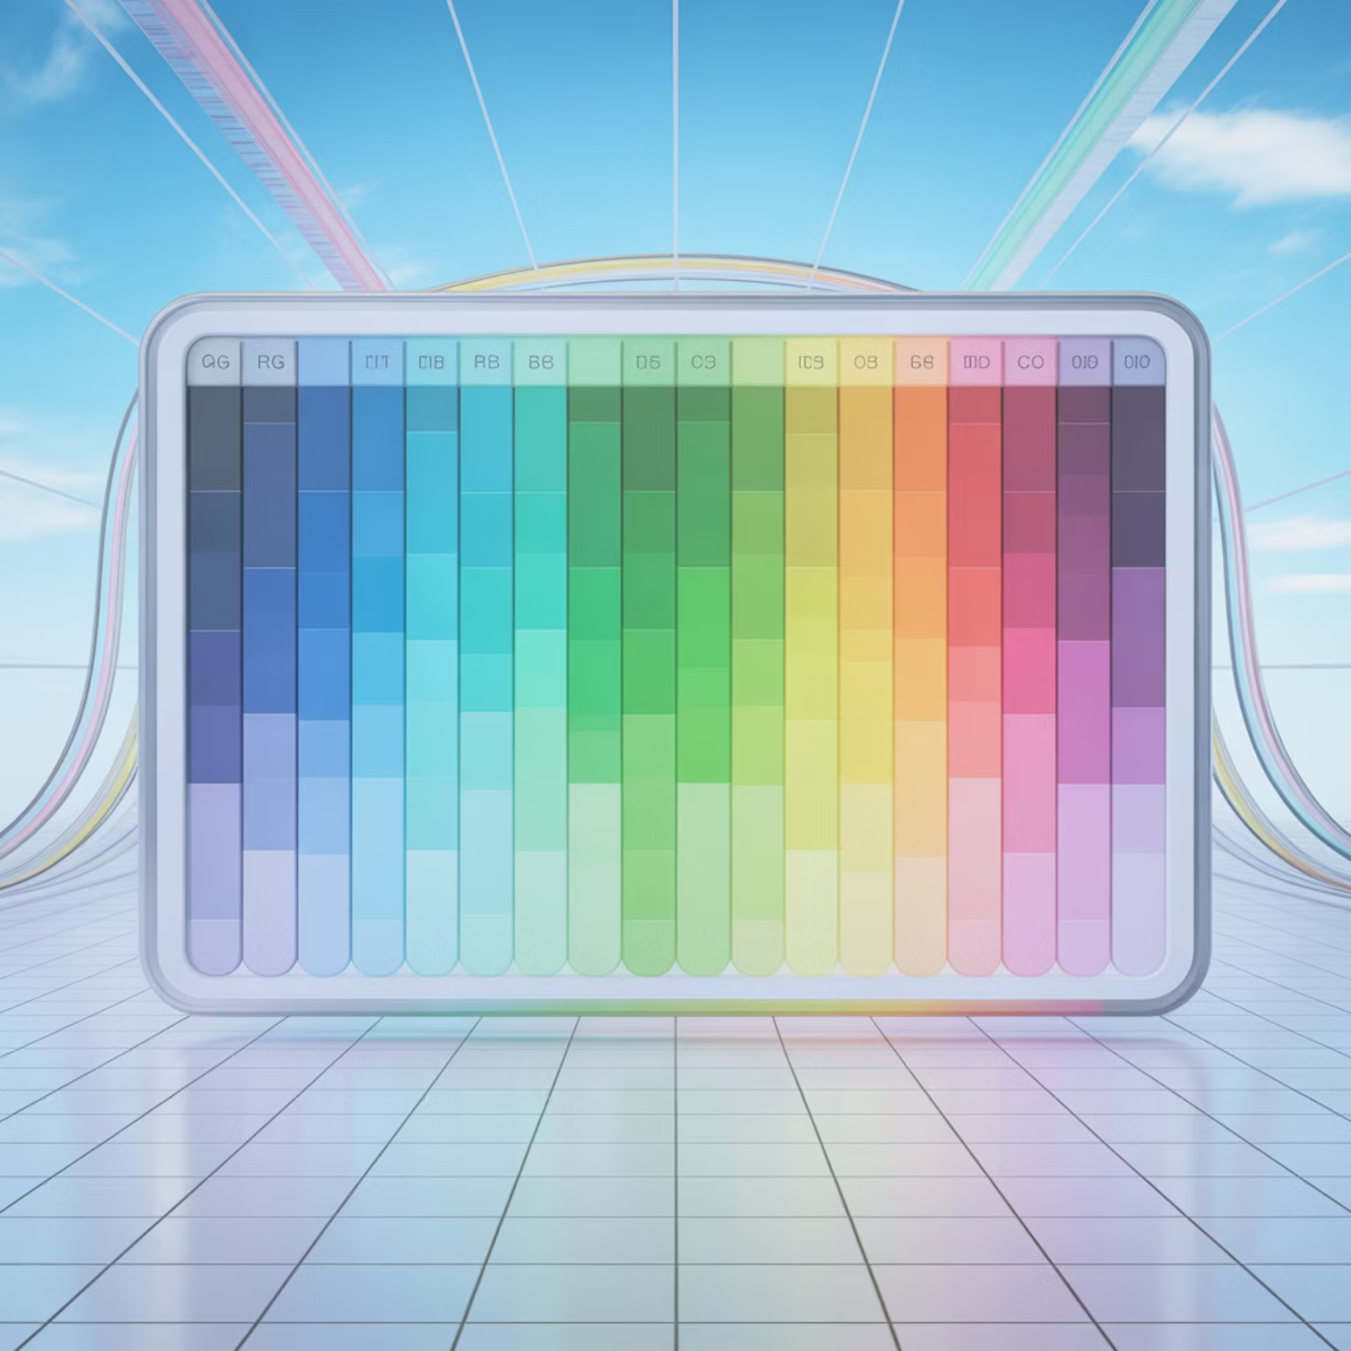
The Grayscale Conversion Formula
Mathematical Foundation
The RGB pixel values are processed mathematically to compute grayscale intensities using a weighted formula that accounts for human eye sensitivity:
This formula reflects how the human eye perceives different colors — we're most sensitive to green, moderately sensitive to red, and least sensitive to blue.

Slide 7
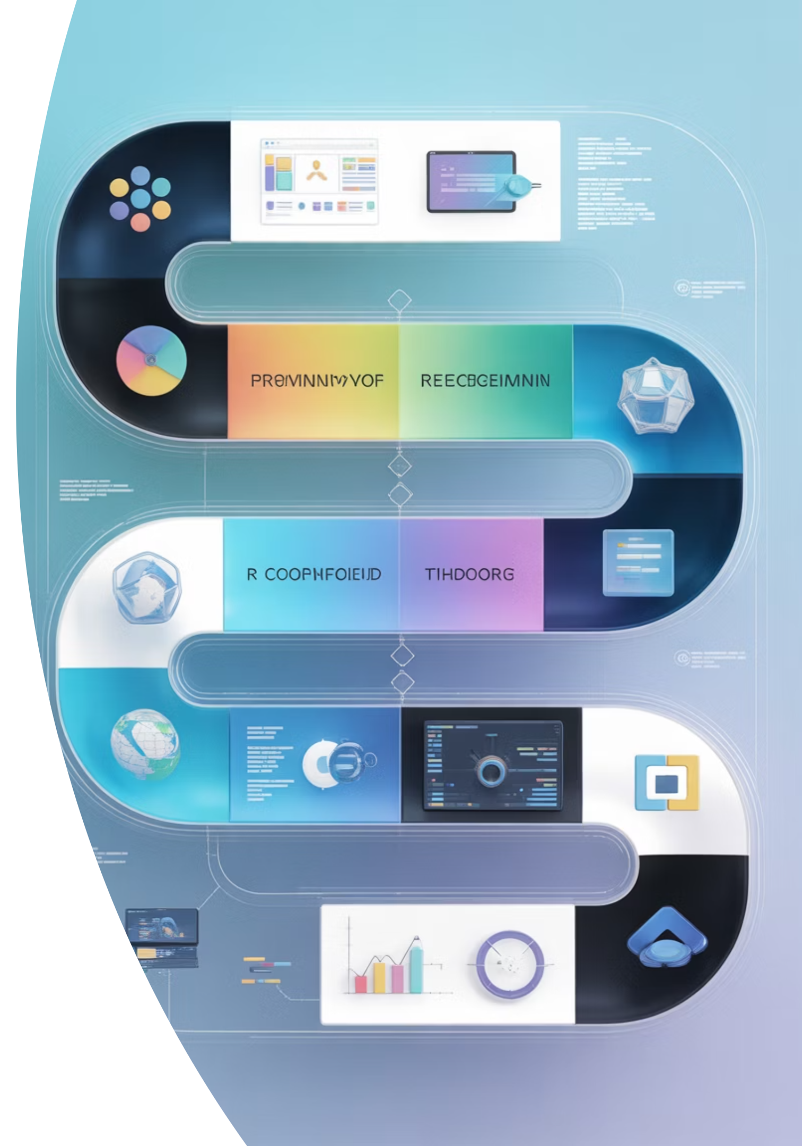
Implementation Methodology
01
02
Image Loading
Image Conversion
User selects or drags an image into the application. The QImage class reads the file into memory. The pixel buffer is accessed using bits() and converted into a NumPy array.
Each pixel's RGB values are extracted from the NumPy array. A linear transformation (dot product) is applied using the weighted coefficients [0.299, 0.587, 0.114]. The output is cast to uint8 type to form a valid grayscale image.
03
Display and Save
The grayscale matrix is transformed back into a QImage object for rendering in PyQt. The user can optionally save the grayscale image in PNG or JPEG format.

Slide 8
Key Technical Insights
Pixel Buffer Access
Byte Padding Resolution
Array Operations
The QImage bits() method provides direct access to raw pixel data, which is then reshaped into a NumPy array for efficient mathematical operations.
Initial vertical line artifacts were resolved by adjusting for bytesPerLine in QImage data, ensuring proper alignment of pixel rows.
NumPy's vectorized operations enable fast processing of entire image matrices simultaneously, avoiding slow pixel-by-pixel loops.

Slide 9

Observations and Results
Performance Metrics
Technical Achievements
The grayscale image produced is visually accurate and matches expected luminance distribution
Successfully resolved byte padding artifacts in QImage data
Achieved seamless integration between PyQt GUI and NumPy processing
NumPy-based pixel manipulation is efficient and fast even for large images
Maintained real-time responsiveness during image conversion
PyQt interface remains responsive, supporting drag-and-drop for better usability
Validated mathematical accuracy of grayscale transformation
Memory consumption remains minimal since only array operations are used

Slide 10




Project Advantages
Lightweight Architecture
Educational Value
Dependency-free implementation using only NumPy and PyQt, resulting in minimal installation footprint and fast startup times.
Demonstrates direct pixel manipulation using NumPy arrays, providing clear understanding of color-to-grayscale transformation principles.
Platform Independent
Efficient Processing
Runs seamlessly across Windows, macOS, and Linux systems. Easy to extend with additional filters or color effects.
Leverages NumPy's optimized C-based operations for fast matrix computations, handling large images with minimal latency.

Slide 11
Current Limitations
Alpha Transparency
Limited Functionality
Processing Speed
Does not currently handle alpha transparency — translucent pixels are ignored during conversion process.
Restricted to grayscale conversion only. No advanced filters or image enhancement features yet implemented.
Processing speed may vary slightly for very large images due to NumPy array reshaping operations.

Slide 12





Future Enhancements
Additional Image Effects
Add support for sepia, blur, contrast adjustment, and other popular image filters using NumPy operations.
Histogram Visualization
Include histogram visualization of grayscale pixel intensities to analyze image distribution and quality.
Real-Time Preview
Integrate real-time preview with sliders for brightness and contrast adjustments before final conversion.
Batch Processing
Extend to batch image processing capabilities, allowing users to convert multiple images simultaneously.
Enhanced Export
Provide export options for different formats and compression levels to optimize file size and quality.

Slide 13
Learning Outcomes
"This project successfully bridges theoretical image-processing formulas with practical, interactive visualization — making it an ideal example of numerical computing applied to real-world graphics."
Technical Skills Developed
Conceptual Understanding
Understanding of RGB data storage and manipulation
Matrix operations for image transformation
Proficiency in NumPy array operations
Human visual perception principles
PyQt GUI development expertise
Software architecture design patterns
Image processing algorithm implementation
User interface best practices

Slide 14

Conclusion
This mini project demonstrates how a simple concept like grayscale conversion can be implemented efficiently using NumPy's matrix operations integrated within a PyQt GUI framework.
It successfully bridges theoretical image-processing formulas with practical, interactive visualization — making it an ideal example of numerical computing applied to real-world graphics. The project reinforces understanding of how RGB data is stored and manipulated, and provides a foundational base for more advanced image-processing projects.
Educational Impact
Practical Application
Future Potential
Demonstrates fundamental concepts in image processing and numerical computation
Delivers a functional, user-friendly desktop application with real-world utility
Establishes foundation for advanced image processing and computer vision projects

